Slide 1

ABE 715
Computer Programming
Lecture 6: Functions & Modular Code
Abstraction, Reusability, and Scope
Dr. Kadeghe G. Fue
Department of Agricultural Engineering
1

Slide 2
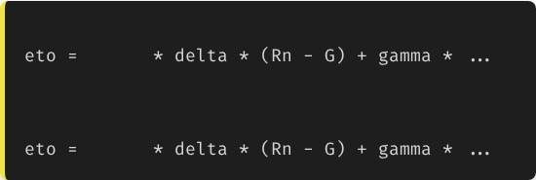

Recap: The Complexity Trap
So far, we have written scripts that run from top to bottom.
# Repeating this everywhere is dangerous:
But what if you need to calculate Evapotranspiration (ETo) in 15 different places in your code?
0.408
# ... 10 lines of math ...
# Later in code...
0.408
The Bad Way: Copy-pasting the same 20 lines of math formula 15 times. If you find a bug, you have to fix it in 15 places!
2

Slide 3

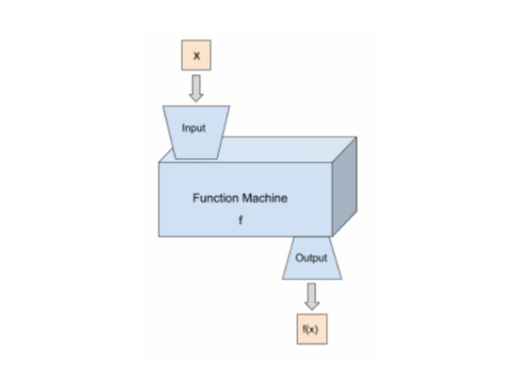
The Concept: The Function Machine
Input → Process → Output
A function is a reusable block of code that performs a specific task.
•
Encapsulation: Hides the complex math inside.
•
Reusability: Write once, call anywhere.
•
Abstraction: You don't need to know how it works, just what it does.
3

Slide 4
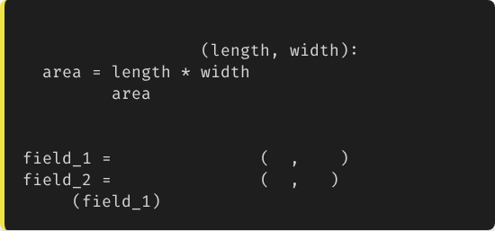
Syntax: def
We use the def keyword to define a function.
# Definition
1.
def keyword.
def
calculate_area
2.
Function Name (snake_case).
return
3.
Parameters in ().
# Usage (Calling the function)
calculate_area
50
100
4.
Colon : and Indentation.
calculate_area
20
30
print
# Output: 5000
5.
return statement (optional but recommended).
4

Slide 5
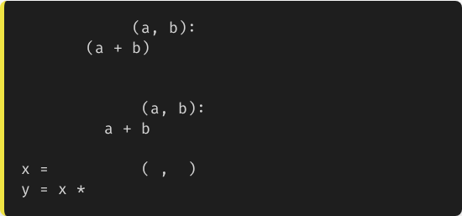
Return vs. Print
Common Newbie Mistake
def
bad_math
print
# Shows on screen, returns None
Printing just shows text on the screen. The computer cannot "use" that result for further math.
def
good_math
return
# Gives data back
Returning passes the value back to the code, so you can store it in a variable.
good_math
5
5
# x becomes 10
2
# We can use x!
5

Slide 6
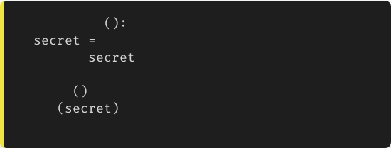
Variable Scope
"What happens in the function, stays in the function."
def
my_func
42
# Local variable
Local Scope: Variables created inside a function die when the function finishes.
return
my_func
print
# ERROR! 'secret' does not exist here.
Global Scope: Variables defined outside functions are visible everywhere (but be careful changing them!).
6

Slide 7


Modules: Using Other People's Code
Don't Reinvent the Wheel
Python has a massive "Standard Library" of pre-written functions.
We use the import keyword to access them.
•
import math (Trig, Pi, Log)
•
import random (Simulations)
•
import time (Delays)
7

Slide 8
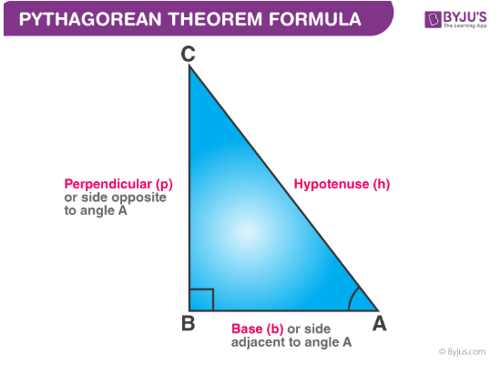
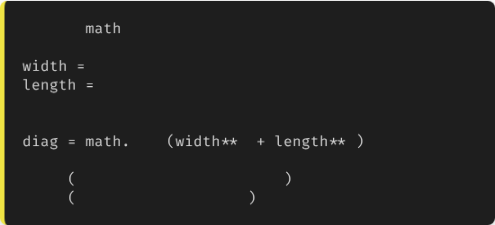
Engineering Math
Example: Hypotenuse
Calculating the length of a pipe running diagonally across a rectangular field.
import
300
400
# Pythagorean theorem: a^2 + b^2 = c^2
sqrt
2
2
print
f"Pipe Length: {diag}m"
print
f"Pi is: {math.pi}"
8

Slide 9




Modular Design
main.py
irrigation_tools.py
analytics.py
The control center. It imports tools and runs the main logic.
Your custom file containing functions like calc_eto() and check_moisture().
Functions for graphing and averaging data.
9

Slide 10
Best Practices
•
Single Responsibility: A function should do one thing well. If it does three things, break it into three functions.
•
Docstrings: The text inside """...""" right after the definition. Essential for documentation.
•
DRY Principle: "Don't Repeat Yourself." If you copy-paste code, make it a function.
def
calc_flow
"""Calculates flow rate Q = V * A."""
return
10

Slide 11

Lecture 6: Take-Home Assignment
The "AgLib" Challenge
Task: Create a Python script that defines two custom functions:
1.
calc_plant_population(area_sqm, spacing_m): Returns the total number of plants.
2.
calc_fertilizer_need(num_plants, grams_per_plant): Returns the total fertilizer in Kilograms (convert grams to kg).
Execution: In the main part of your script, call these functions to calculate the fertilizer needed for a 2-hectare field (20,000 sqm) with spacing 0.5m x 0.5m (0.25 sqm per plant) and a dose of 10g per plant.
Print the final result in kg.
11

Slide 12
Questions?
Next Class: Data Analysis with NumPy & Pandas
Dr. Kadeghe G. Fue
Department of Agricultural Engineering
12

